Slide 1
Trauma Informed Meaningful Access and Effective Communication with clients with limited-English proficiency.
This project was supported by Grant No. 15JOVW-21-GK-02218-MUMU awarded by the Office of Violence Against Women, U.S. Department of Justice. The opinions, findings, conclusions and recommendations expressed in this publication/program/exhibition are those of the author(s) and do not necessarily reflect the views of the Department of Justice, Office on Violence Against Women.

Slide 2
Interpretation Technical Assistance Resource Center
ITARC is the comprehensive technical assistance and training provider to OVW funded grantees; national organizations; state coalitions; and local programs on language access and interpretation. Our expertise focuses on: Title VI compliance, language access plan development and implementation; spoken language interpretation; sign language interpretation for deaf victims who do not use ASL; compliance with federal and state language access laws and policies; emphasizing the distinctions between bilingual advocacy and interpretation; and, compiling resources and producing materials that enhance program development and practice.

Slide 3
Learning Objectives
Articulate the language access requirements of Title VI of the Civil Rights Act of 1964.
Describe 2-3 considerations when working with survivors with limited-English proficiency to ensure trauma informed practices.
Identify resources to help improve language access plans.

Slide 4


Why we’re talking about language access
Complexity of Battered Women’s Lives, Ellen Pence
Notes:
Slides 3-9 discuss/illustrate multiple points of contact encountered by LEP individuals, and the impact that lack of access at any one point of contact can have ripple effect across systems.

Slide 5
Relief Granted
Safety planning learns about VAWA, T or U
No Relief Available
Gets Attorney
Not Detained
Relief Denied
Detained
Put into immigration proceedings
Remain undocumented, gets victim services
Collect documents
Relief denied
Relief granted
Appeals exhausted
Removed from US
IMMIGRATION MAP

Slide 6
Immigrant victim fearful to seek help because of fear of deportation
Victim trusts law enforcement
Squads Investigate
Victim arrested
Screen for victim’s immigration status
Arrest
No Arrest
911 Call by neighbor
or
Victim’s 911 Call
Arrest Report
Non-Arrest Report
Do they investigate all?
Jail
Immigration Detainer
DHS/ICE Removal of abuser
Police U Visa Certification
Pre-trial
Sentencing
Prosecutor U visa certification
Trial
Judge U visa certification
DOMESTIC VIOLENCE/ ARREST INCIDENT

Slide 7
FAMILY COURT
Reunified
Abuser introduced evidence about immigration status
Reunification case plan
Immigration considerations detention?
DHS shows up in court
Termination of parental rights
Files for Divorce
Child Protective System Case
Family Court Hearing
Abuser raises immigration status as a factor in custody.
Home evaluation/ cultural competency issues
Temporary Custody
Supervised Exchange/Visitation, money required
Interviews by Evaluator
Custody Awarded
Custody Evaluation
Custody Hearing, including issues of parental kidnapping
Abuser Removed
Final Divorce Hearing
Child Support Established
Abuser undocumented, court imputes income but difficult to get a wage withholding

Slide 8
BENEFITS MAP
Seeks NGO Assistance
Immigrant victim tries to access benefit
Denied
Receives Benefit
No Benefit
Reported to DHS Children taken away

Slide 9
PROTECTION ORDER – CIVIL COURT PROCESS
DHS shows up at court
Abuser introduces immigration status to prevent protection order
Civil Court hearing including creative orders for immigrants
CPO Denied
CPO Granted
U Visa certification signed
Sheriff Serves Respondent
Files CPO
Must get notice in native language (LEP)
Temporary/Permanent

Slide 10
Immigrant victim fearful to seek help because of fear of deportation
Relief Granted
Victim trusts law enforcement
Safety planning learns about VAWA, T or U
No Relief Available
Gets Attorney
Squads Investigate
Victim arrested
Not Detained
Relief Denied
Detained
Put into immigration proceedings
Remain undocumented, gets victim services
Screen for victim’s immigration status
Arrest
No Arrest
911 Call by neighbor
or
Victim’s 911 Call
Arrest Report
Non-Arrest Report
Collect documents
Do they investigate all?
Relief denied
Relief granted
Jail
Immigration Detainer
DHS/ICE Removal of abuser
Appeals exhausted
Police U Visa Certification
DHS shows up at court
Pre-trial
Sentencing
Removed from US
Judge U visa certification
Abuser introduces immigration status to prevent protection order
Prosecutor U visa certification
Trial
Civil Court hearing including creative orders for immigrants
Seeks NGO Assistance
Denied
Immigrant victim tries to access benefit
CPO Denied
Receives Benefit
No Benefit
CPO Granted
Reported to DHS Children taken away
Reunification case plan
Reunified
Immigration considerations detention?
DHS shows up in court
Abuser introduced evidence about immigration status
U Visa certification signed
Files for Divorce
Termination of parental rights
Sheriff Serves Respondent
Family Court Hearing
Child Protective System Case
Files CPO
Abuser raises immigration status as a factor in custody.
Home evaluation/ cultural competency issues
Temporary Custody
Must get notice in native language (LEP)
Temporary/Permanent
Interviews by Evaluator
Custody Awarded
Supervised Exchange/Visitation, money required
Custody Evaluation
Custody Hearing, including issues of parental kidnapping
Abuser Removed
Final Divorce Hearing
Child Support Established
Abuser undocumented, court imputes income but difficult to get a wage withholding
Notes:
c

Slide 11
Title VI of the Civil Rights Act
No person in the United States shall, on the ground of race, color, or national origin, be excluded from participation in, be denied the benefits of, or be subjected to discrimination under any program or activity receiving Federal financial assistance.
Civil Rights Act of 1964, Title VI, 42 U.S.C. § 2000d

Slide 12
Meaning
If you are receiving federal funds, then all your programs, activities, and benefits must be language accessible.
If you are using federal funds to fund grantees, your grantees must provide meaningful language access to all their programs, activities, and benefit.

Slide 13

“MEANINGFUL ACCESS”
Language assistance that results in accurate, timely, and effective communication at no cost to the LEP individual. For LEP individuals, meaningful access denotes access that is not significantly restricted, delayed or inferior as compared to programs or activities provided to English proficient individuals.”
US Department of Justice’s Language Access Plan
Notes:
Language access clearly enhances safety. Without it, the survivor cannot interact fluently with an advocate and other service providers.
Research in the domestic and sexual violence fields shows that survivors appreciate and feel more supported when language access services are provided.

Slide 14
“Limited English Proficient”
The ability to communicate effectively in English for individuals who speak English as a second, third, or fourth language is impacted by the situation, stress, and the subject matter.
What language do you most effectively communicate in?
What if you’ve experienced trauma?
Notes:
Language access clearly enhances safety. Without it, the survivor cannot interact fluently with an advocate and other service providers.
Research in the domestic and sexual violence fields shows that survivors appreciate and feel more supported when language access services are provided.

Slide 15
Definitions
Interpretation - Process of orally rendering communication from one language to another language (Interpreter)
Translation – preparation of a written text from one language into an equivalent form in another language (translator)
Qualified Bilingual Employee: Employee who identify themselves as “bilingual” must demonstrate, through a formal procedure which has been established by the Employer, competency to communicate in the language.

Slide 16
Modes of Interpretation
Simultaneous – The process of orally rendering one language into another language virtually at the same time that the speaker is speaking.
Consecutive – The process of orally rendering one language into another language after the speaker has completed a statement or question.
Sight Translation – The rendering of material written in one language into spoken speech in another language.

Slide 17
The Qualified Interpreter
A qualified interpreter, is an interpreter that meets the requirements and standards recommended by the Department of Justice, and established by your department or agency to interpret competently and accurately, and ensure your ability to effectively communicate with individuals with limited-English proficiency.
Notes:
Language access clearly enhances safety. Without it, the survivor cannot interact fluently with an advocate and other service providers.
Research in the domestic and sexual violence fields shows that survivors appreciate and feel more supported when language access services are provided.

Slide 18
Bilingual vs Interpreter
Bilingual staff
Fluent in English and native language
Not a conduit or neutral party
No government standard, but recommends assessment
Qualified
Interpreters
Spoken language from one language to another
Training
Neutral party
Fluency in English and native language
Conduit to communicate
In-person
Telephonic

Slide 19
Interpretation Exercise
Please listen to the short sentence I read, and then try to repeat everything I’ve just read.
Notes:
At about 7:15 pm, a blue station wagon, maybe 1981 Ford, southbound, approached the intersection of 35thN.E. and N.27th. There was a stop sign I think, but the driver did not stop and hit the other car. He was wearing a black hat, had brown hair, maybe 5’6” or 5’7”, and wearing a white shirt. He got back in and sped away.

Slide 20
Trauma and Interpreting
The linguistic community (including Deaf) is a small community, and interpreters know the lives of many members.
Not all interpreters are trained in or thoroughly knowledgeable about DV/SA and trauma informed practices.
Some interpreters are themselves victims or perpetrators.
You may need more time
Interpreters have privilege of power: having the status of being “Hearing” or can speak English.
Victims may specify a gender preference for an interpreter. You should consider time, resources, and any exigency.

Slide 21
Understanding Interpreter Discomfort
Interpreter discomfort is a significant barrier to addressing survivors’ experiences and effective communication.
Interpreter misconceptions, stereotypes, and biases impacts interpretation.
Interpreter bias/discomfort impacts your relationship with your client.
Notes:
Highlight additional considerations when using interpreters for individuals who have experienced trauma

Slide 22
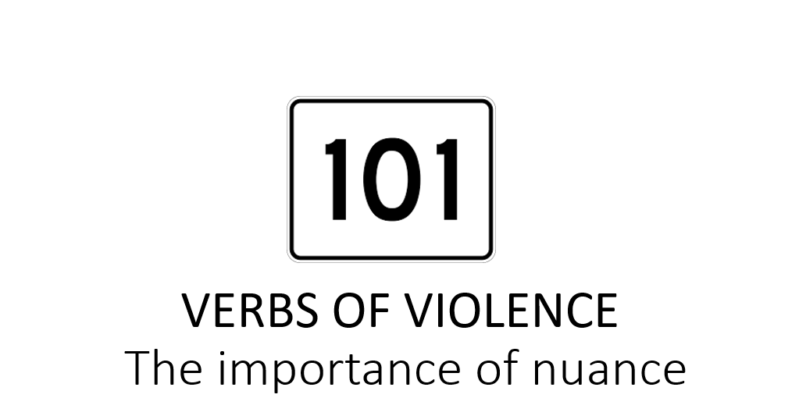
Handout – Verbs of Violence

Slide 23
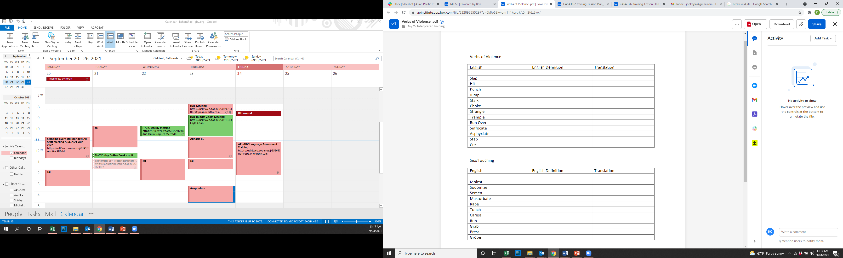

Slide 24

Language Access Plan
A Language Access Plan is a strategy to assess, identify, and manage a system to ensure that individuals with limited English proficiency (LEP) or Deaf/Hard of hearing individuals are able to fully access services.
Notes:
Note to facilitator: The following slides, SLIDES 12-48, will provide a general overview of the steps that need to be taken by agencies/organizations in order to develop and implement an effective language access plan that will meet the language needs of individuals with limited English proficiency or those of Deaf/Hard of hearing individuals.
Instructions for facilitator:
Begin by reading SLIDE 12 aloud to participants.
Continue by posing the following question to participants, “What are your thoughts around formalizing the way in which agencies/organizations provide meaningful language access? What do you think is involved in that process? What would it look like? What components do you think might critical to include?
Allow for participants to share their thoughts aloud. Feel free to capture their thoughts on a flipchart. You can use this information at the end of the session to identify which components participants were able to identify prior to being exposed the information you will be sharing.
The first step in standardizing and documenting our language access practices, begins by developing a formal, written language access plan. Share that you will be sharing a step by step process, that explores the components necessary when developing an effective language access plan.
You’ll be walking them through a practical and tangible approach for developing a language access plan. It’s meant to be a practical and easy to use approach, to help make language access planning less intimidating. Share that developing a language access plan is a process, it’s not something that can be done overnight. Share that we all have to start somewhere and that this is our somewhere. The following approach can help move an agency/organization from having no formalized language access plan to their first formal, written language access plan.

Slide 25
Steps to Language Access Planning
Convene
Assess
Collaborate
Objectives, Timeframe
Who Will Implement
Funding
Formalize
Implement
Training
Outreach
Monitor
Notes:
Source: Enhancing Services for Survivors with Limited English Proficiency, Casa de Esperanza, 2016
Instructions for facilitator: This is very hard to read
This is a snapshot of the components that make for an effective language access plan.
2. Walk through it, and briefly explain each box. Continue by reading each box aloud to the group.
It’s a useful visual reference to have readily available when working with a work group to develop a plan.
Box #1 – The first step in developing a language access plan includes convening a multi-functional team.
Box #2 – The second step in developing a language access plan is to conduct a demographic assessment of the limited English proficient communities in their services area. This includes looking at demographic data outside of the organization, as well as looking at data already compiled within the organization, i.e. demographics of participants served over a 1-2 year period, etc.
Box #3 – Agencies/organizations reach out to, and informally partner with culturally specific organizations to provide “in-kind” interpretation/translation services. As a result culturally specific organizations, feel the burden of the cost, hours and labor without adequate support or resources. Partnering with culturally specific organizations requires equitable and reciprocal partnerships that build resources and collaboration efforts so that both mutually benefit. It’s critical to compensate culturally specific organizations for their expertise, and for the value they bring to this process.
Box #4 – Read aloud, and share that prior to embarking on the journey of creating a language access plan, a language access plan work group should be established, in addition to being responsible for the development of the language access plan, this group will also be responsible for developing timelines/deadlines, the objectives informing the development of the plan, tracking mechanisms for measuring effectiveness of language access plan.
Box #5 – These individuals are often part of the work group responsible for developing, implementing and monitoring the language access plan. It is a wise idea to have a cross section of staff from across the agency/organization from varying work areas i.e. finance, training, policy, victim advocates, management, leadership.
Box #6 – Refers to taking an internal look at what monies have been set aside, where funding can be allocated from, assessing how much needs to be set aside, etc.
Box #7 – Refers to the process of formalizing your language access policy by documenting current practices, developing protocols, policy statements, etc.
Box #8 – Refers to how the plan will me implemented, by whom and when.
Box #9 – Refers to who within an agency/organization will be trained, by whom, when and how often.
Box #10 – Refers to informing community members and other agencies/organizations that as an agency/organization, you have the mechanisms in place to meet the language access needs of individuals with limited English proficiency, or Deaf/Hard of hearing individuals. It requires thinking about how you will make your language accessibility known i.e. social media, community meetings, email blasts. Remember that once you communicate to communities that you are language accessible, you must deliver language access services.
Box #11– Refers to evaluating the effectiveness of the language access plan, i.e. is it meeting the needs of individuals accessing language access services, how many individuals have utilized language access services, are staff implementing the plan with fidelity, which policies need to be revisited, have service area demographics changed. Share with participants that Monitoring will be explored in more detailed manner in Module 7.

Slide 26
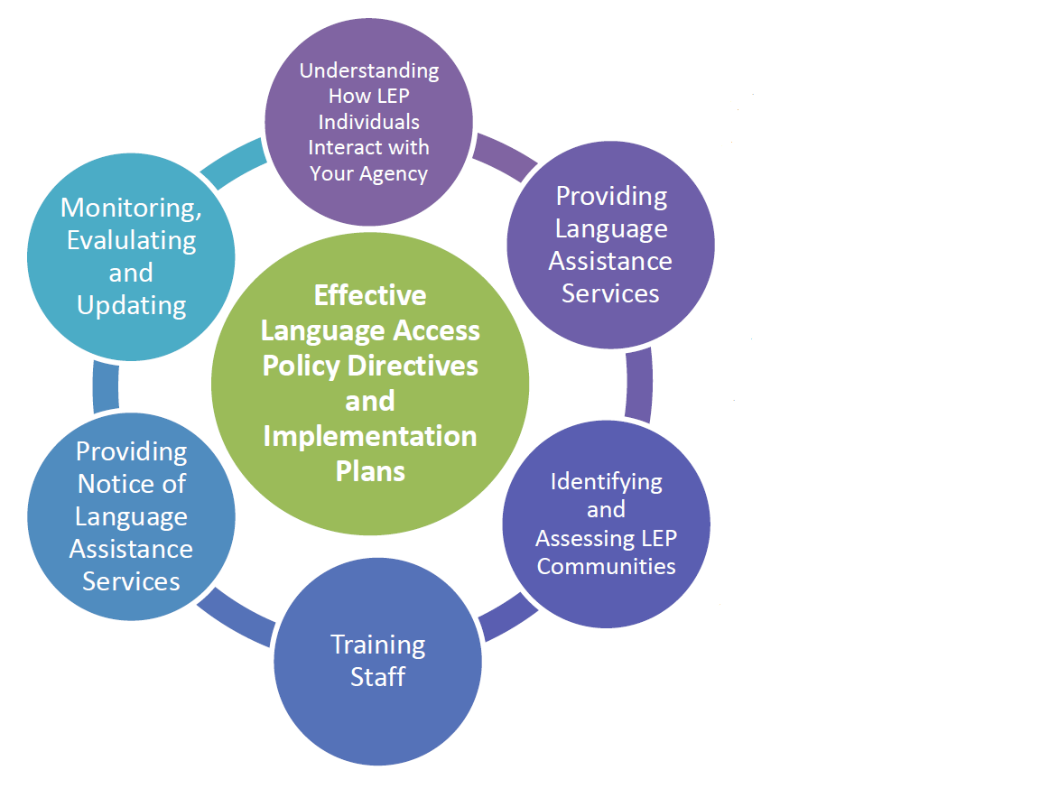
Creating a Language Access Plan
Language Access Assessment and Planning Tool for Federally Conducted and Federally Assisted Programs U.S. Dept. of Justice. May 2011

Slide 27
Elements of a Language Access Plan
Identification of Communities with LEP and/or who are D/HOH and their Interaction with DOJ
Identification of Individuals with LEP and/or who are D/HOH and their Primary Language or Method of Communication
Quality Assurance and Control
Outreach and Engagement with Communities with LEP and/or who are D/HOH
Procurement
Allocation of Resources
Department of Justice Language Access Plan Guidelines, 2023.

Slide 28
Elements of a Language Access Plan
Notification of the Availability of Language Assistance Services
Provision of Language Assistance Services
Multilingual and Accessible Digital Content
Staff Training
Hiring Practices and Access to Multilingual Staff
Departmental and Interagency Cooperation
Performance Measurement and Evaluation
Department of Justice Language Access Plan Guidelines

Slide 29
Translation
Programs should provide translation of vital written materials into the language of each frequently-encountered LEP group eligible to be served and/or likely to be affected by the recipient’s program.

Slide 30
Vital Documents
Documents related to the services provided: including but not limited to: notice of rights; intake and application forms; consent and complaint forms; notices of denials, losses, or decreases of benefits.

Slide 31
Technology
Video Remote Interpreting (VRI)
Video Relay Service (VRS)
Telephone Interpretation
Communication Access Realtime Translation (CART) or Speech to Text Captioning
Instant or Text Messaging
Real time machine translation

Slide 32
Confirming our “meeting”
A word about Google Translate and other forms of mechanized translation.

Slide 33
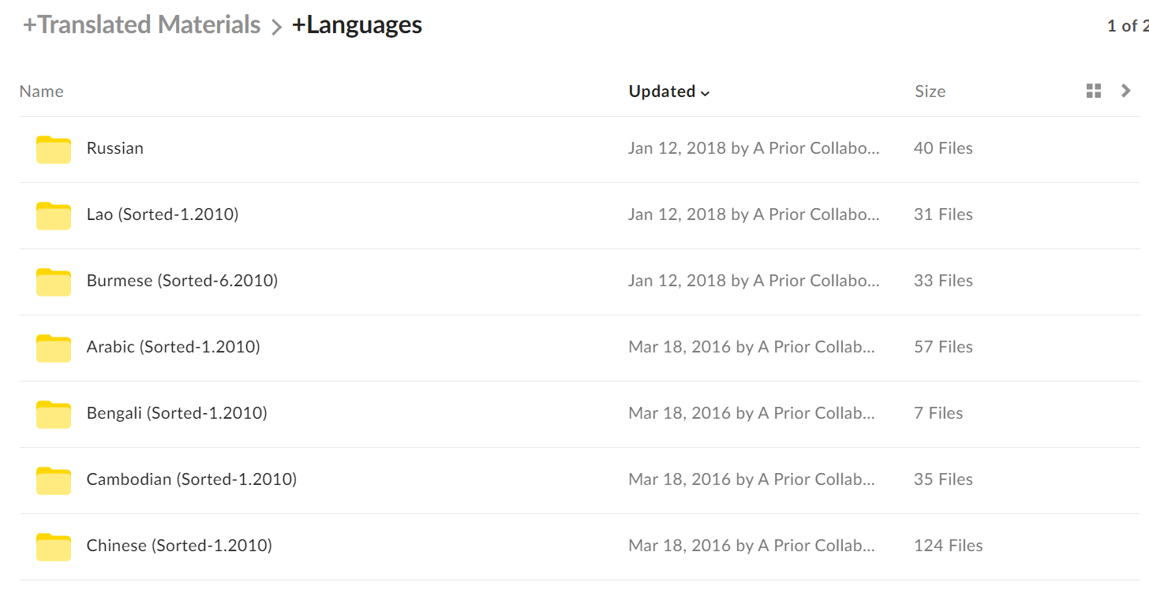

Slide 34
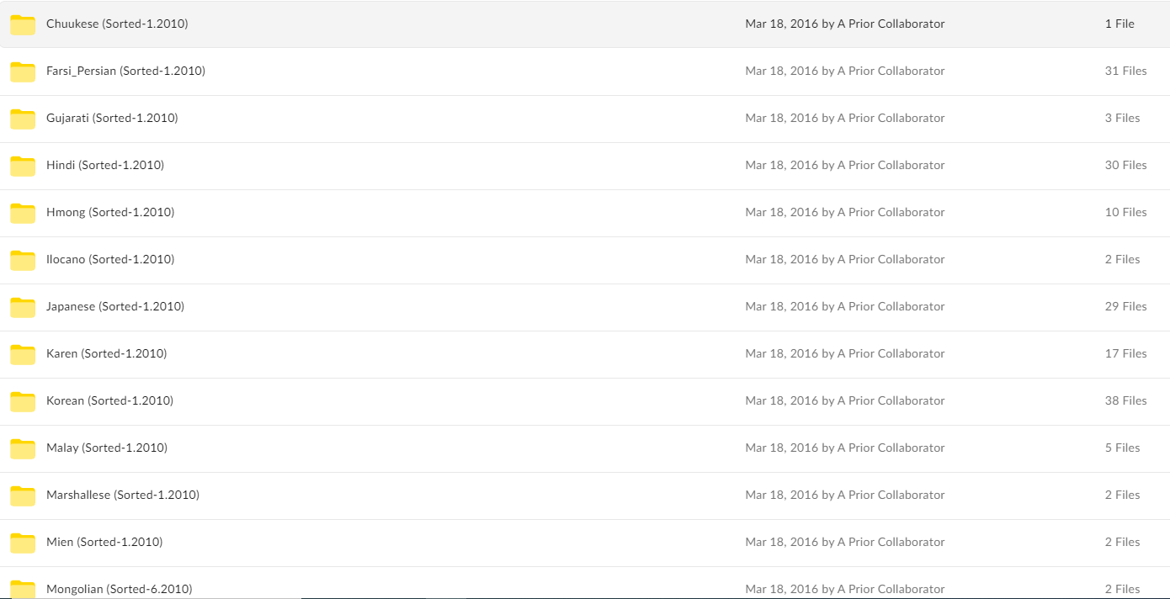

Slide 35
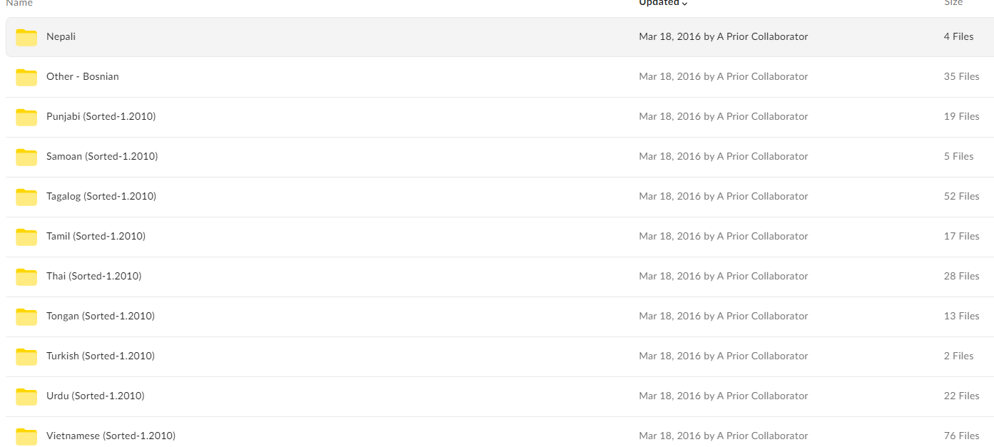

Slide 36
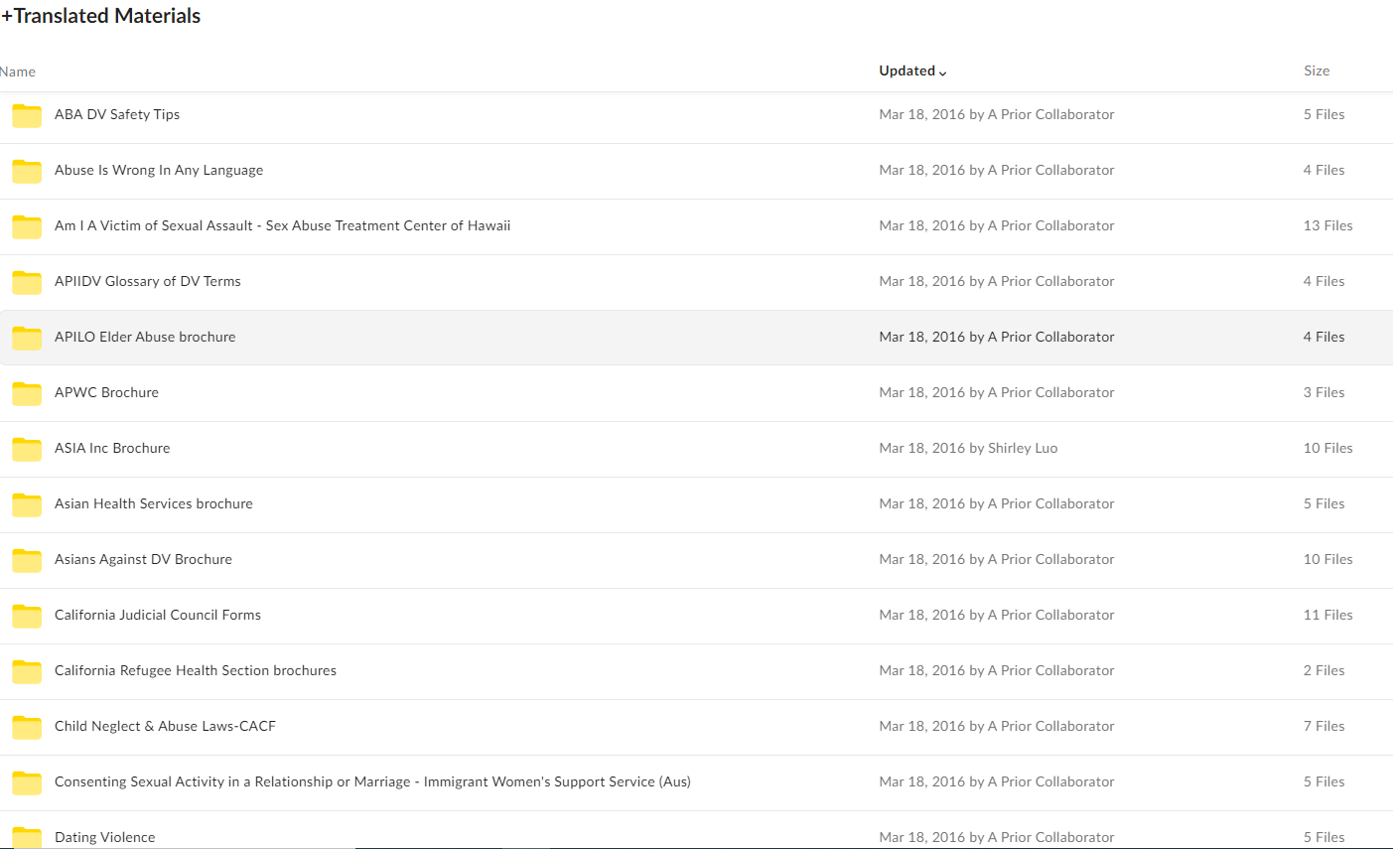

Slide 37
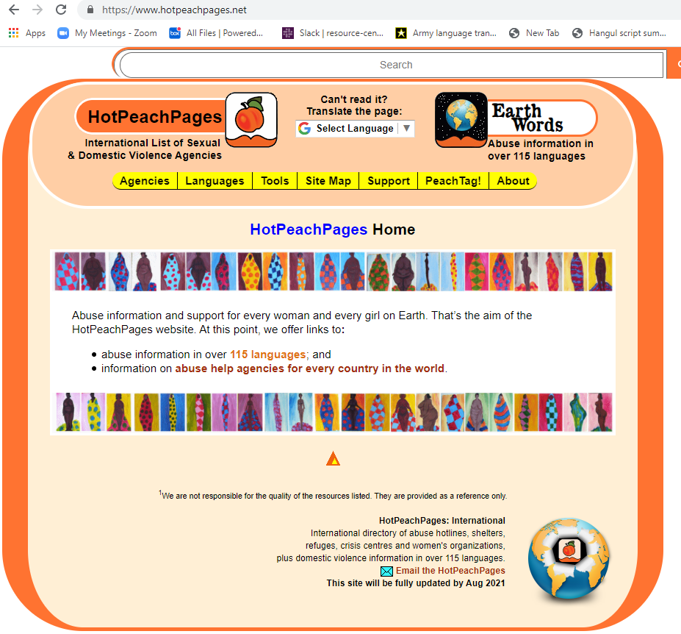
www.hotpeachpages.net

Slide 38
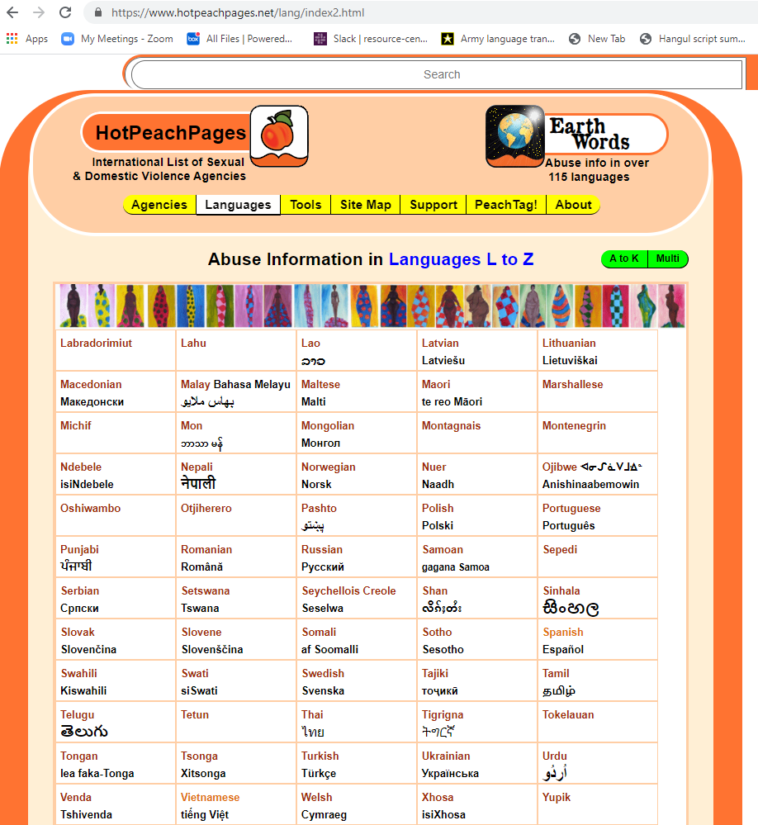
www.hotpeachpages.net/

Slide 39
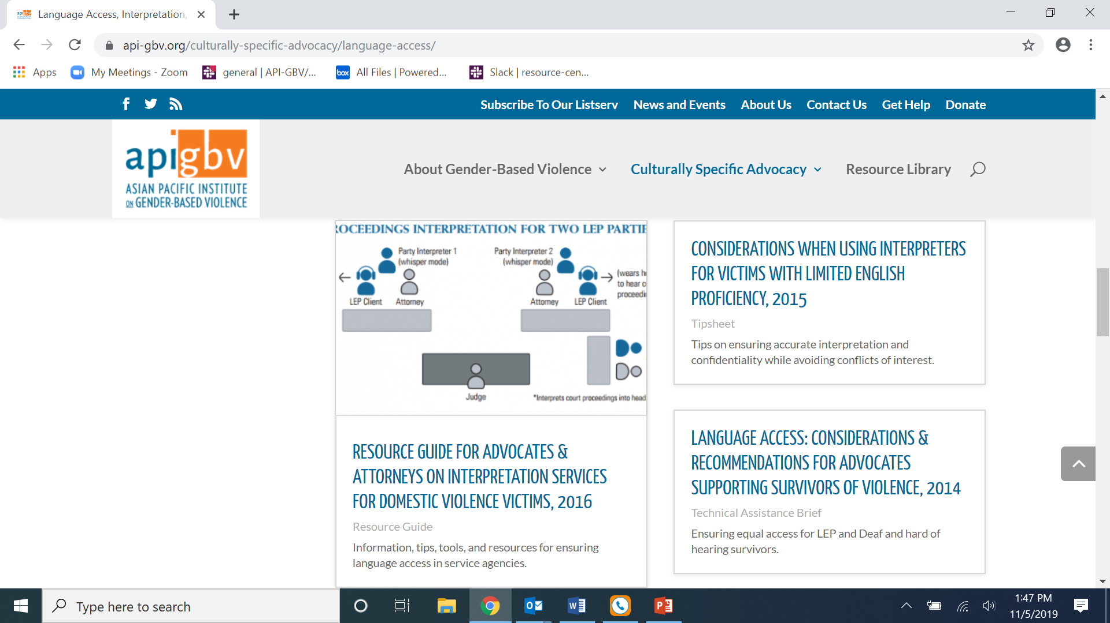

Slide 40
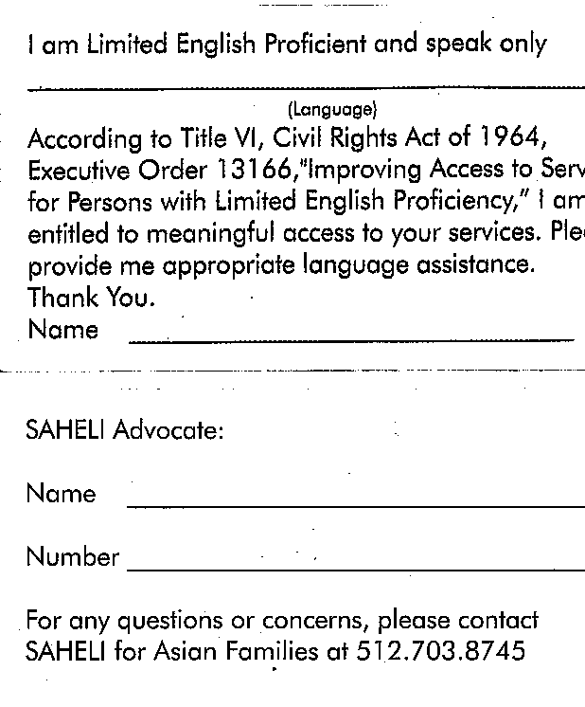
I speak cards

Slide 41
Resources
Interagency Language Roundtable www.govtilr.org/
Lep.gov
Multilingual Advocate Model
  www.sfaws.org/programs/direct-services/language-access.aspx
Community Legal Interpreter Bank
  www.ayuda.com/index.cfm/community-legal-interpreter-bank
“Serving Limited English Proficient (LEP) Battered Women: A National Survey of the Courts’ Capacity to Provide Protection Orders”
  www.ncsconline.org/D_Research/Documents/LEP_NIJFinalReport.pdf

Slide 42
National Resource Center providing Training & Technical Assistance
Lifetime Spiral of Gender Violence
Abusive International Marriages
Domestic Violence
Engaging Men Transforming Gender Roles
Facts & Stats
Forced Marriage
Homicide and Asian Families
Islamic Immigration Policies affecting Survivors
Marriage Contracts
Language Access, Interpretation
Lifetime Spiral of Gender Violence
Sexual Violence
Trafficking
Translated Materials

Slide 43
Cannon Han
415-568-3314 | chan@api-gbv.org

